Slide 1

MCSE Guide to Microsoft Windows 7
Chapter 3
Using the System Utilities

Slide 2
Objectives
Understand and use the Control Panel applets
Understand the Administrative Tools
Manage hardware components
Understand and configure power management
Configure the display
Use Task Scheduler

Slide 3
Control Panel Overview
Control Panel
  Central location for management utilities
Applet
  Small application or utility that is used to perform management tasks in Windows 7
By default, Control Panel uses Category view
  Offers an intuitive way for less experienced computer users

Slide 4
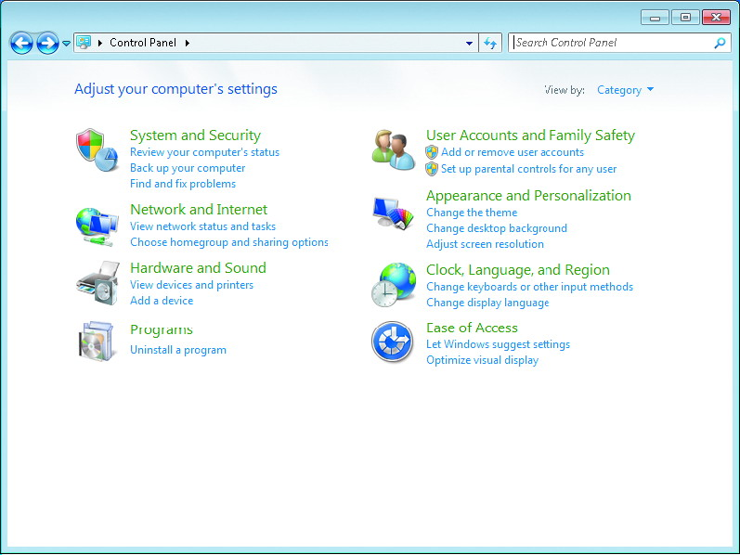
Control Panel Overview (cont'd.)

Slide 5
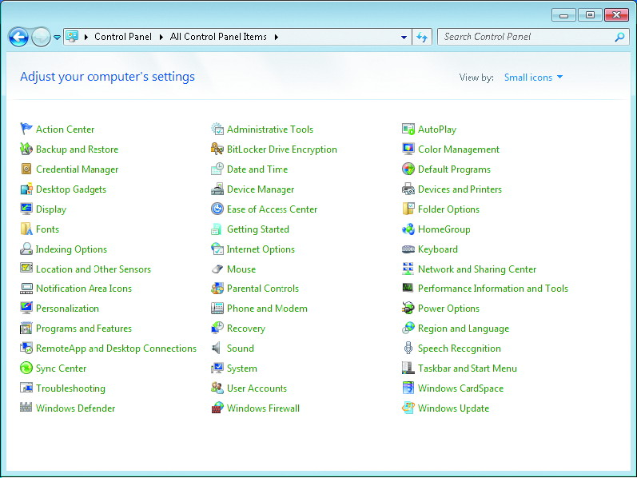
Control Panel Overview (cont'd.)

Slide 6
System and Security
Wide range of applets for managing Windows 7
Applets include:
  Action Center
  Windows Firewall (covered in chapter 8)
  System
  Windows Update (covered in chapter 7)
  Power Options
  Backup and Restore (covered in chapter 12)
  BitLocker Drive Encryption (covered in chapter 7)
  Administrative Tools

Slide 7
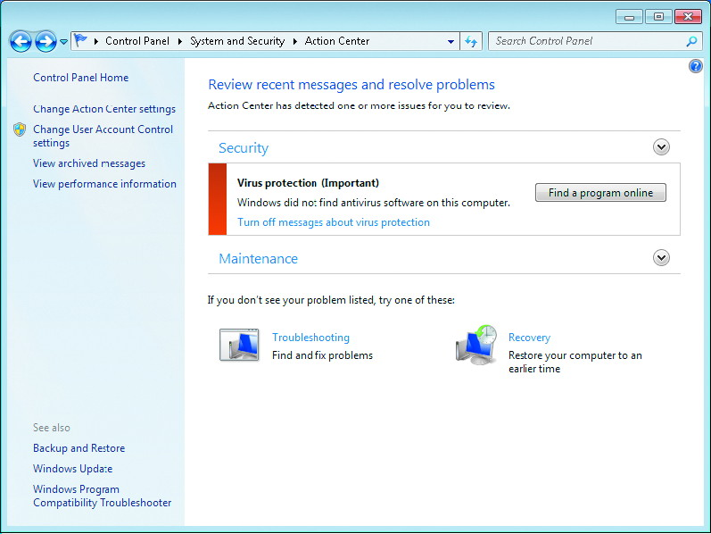
Action Center Applet

Slide 8
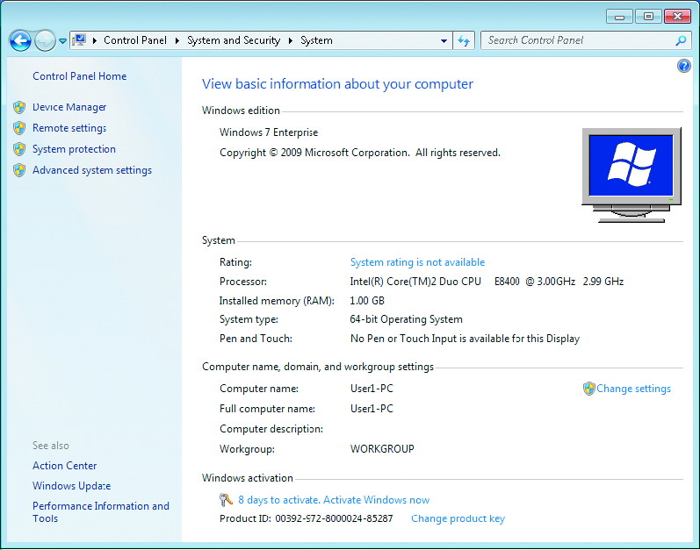
System Applet

Slide 9
Network and Internet
Applets for configuring network communication
Applets include:
  Network and Sharing Center (covered in chapter 8)
  HomeGroup (covered in chapter 8)
  Internet Options (covered in chapter 9)

Slide 10
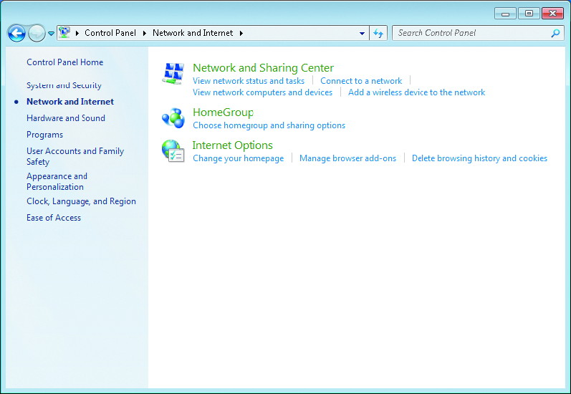
Network and Internet (cont'd.)

Slide 11
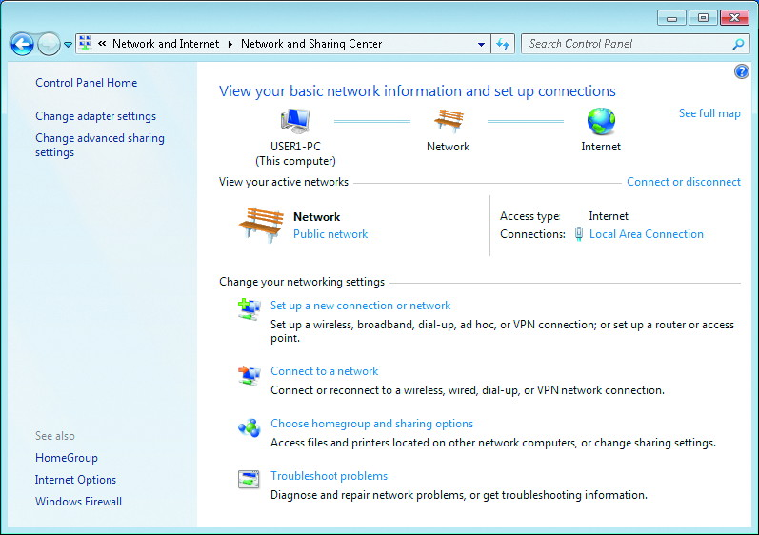
Network and Sharing Center Screen

Slide 12
Hardware and Sound
Configure a wide range of hardware settings
  For most device types, this category does not allow you to configure device drivers
Applets include:
  Devices and Printers
  AutoPlay
  Sound
  Power Options
  Display
  Windows Mobility Center
  Biometric Devices
  Tablet PC Settings

Slide 13
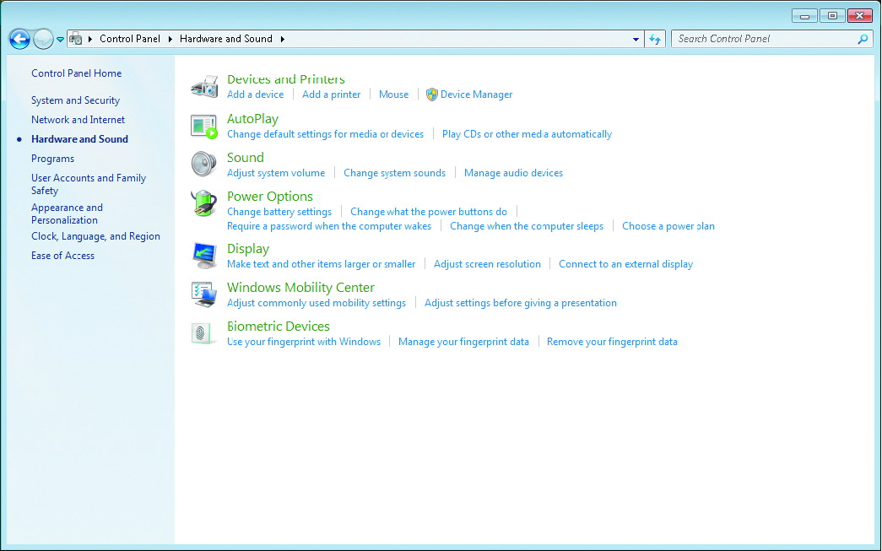
Hardware and Sound Main Screen

Slide 14
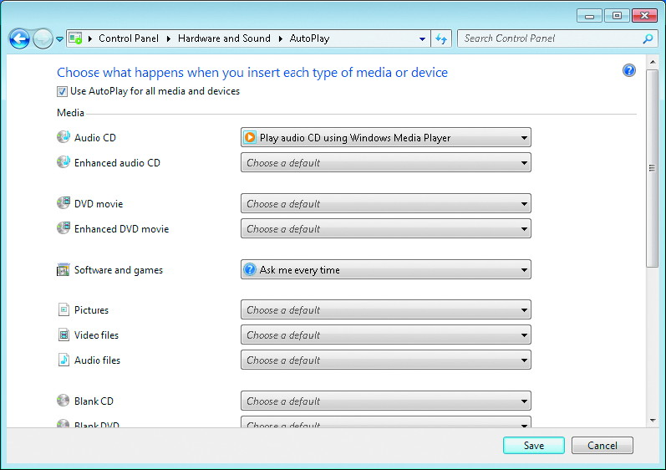
AutoPlay Screen

Slide 15
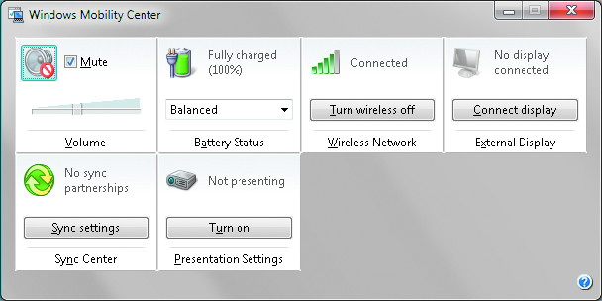
Mobility Center Screen

Slide 16
Programs
Applets to install, manage, and uninstall applications
Applets include:
  Programs and Features
  Default Programs
  Desktop Gadgets

Slide 17
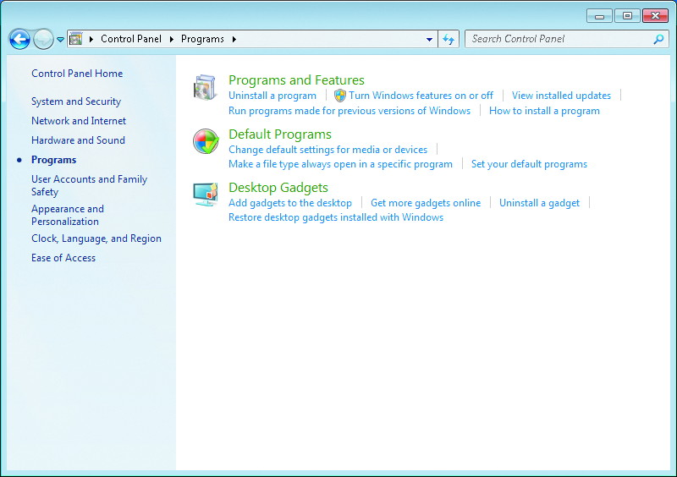
Programs Main Screen

Slide 18
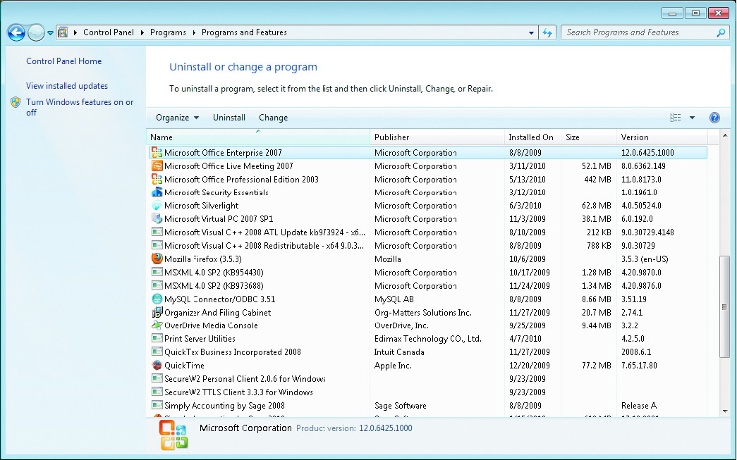
Programs and Features Screen

Slide 19
User Accounts and Family Safety
Configure user accounts and parental controls
Applets include:
  User Accounts (covered in chapter 6)
  Parental Controls (covered in chapter 6)
  Windows CardSpace
  Credential Manager

Slide 20
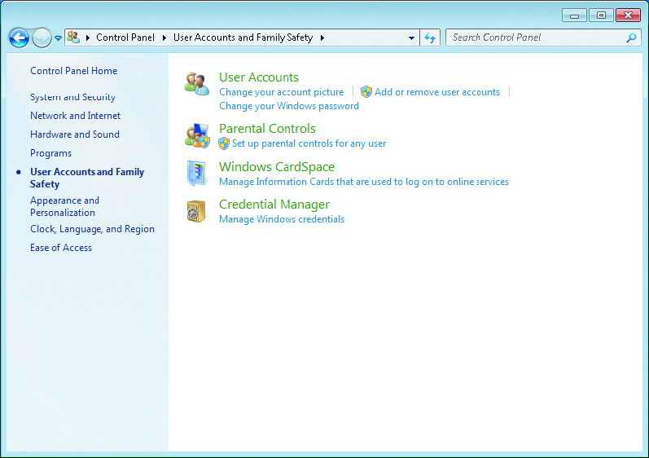
User Accounts and Family Safety Main Screen

Slide 21
Appearance and Personalization
Modify the user interface for Windows 7
Applets include:
  Personalization
  Display
  Desktop Gadgets
  Taskbar and Start Menu
  Ease of Access Center
  Folder Options
  Fonts

Slide 22
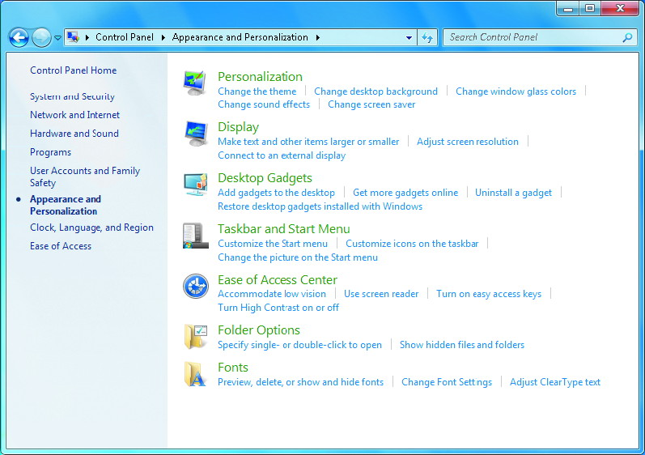
Appearance and Personalization Main Screen

Slide 23
Clock, Language, and Region
Applets for configuring time, regional format, and language settings
Applets include:
  Date and Time
  Regional and Language Options

Slide 24
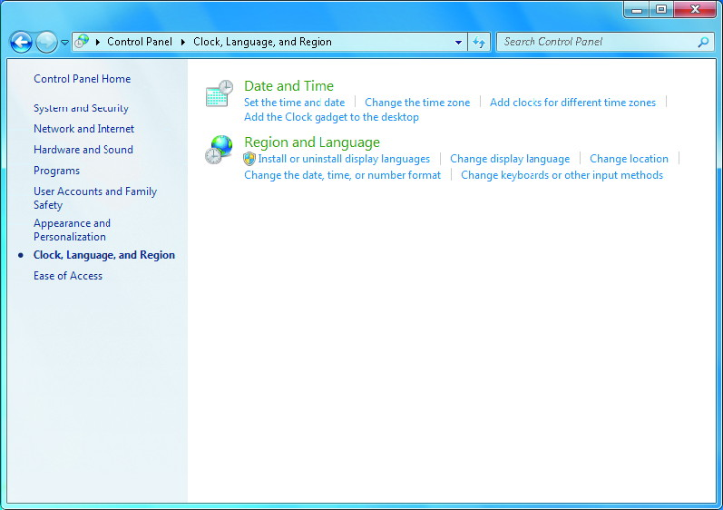
Clock, Language, and Region Main Screen

Slide 25
Ease of Access
Makes Windows 7 easier to use
Applets include:
  Ease of Access Center
  Speech Recognition Options

Slide 26
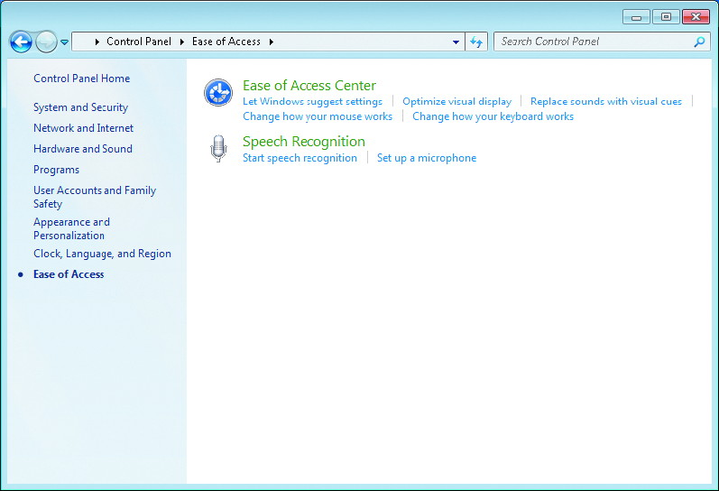
Ease of Access Main Screen

Slide 27
Administrative Tools
Utilities include:
  Component Services
  Computer Management
  Data Sources (ODBC)
  Event Viewer (covered in chapter 12)
  iSCSI Initiator
  Local Security Policy (covered in chapter 7)
  Performance Monitor (covered in chapter 10)
  Print Management
  Services
  System Configuration
  Task Scheduler
  Windows Firewall with Advanced Security
  Windows Memory Diagnostic
  Windows Powershell Modules

Slide 28
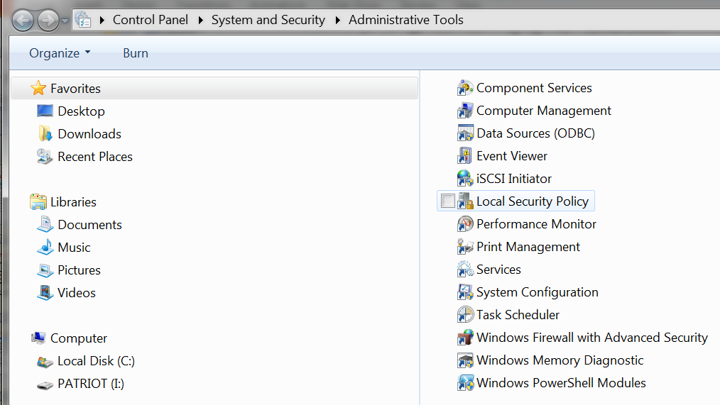
Administrative Tools Main Screen

Slide 29
Microsoft Management Console
Graphical interface shell that provides a structured environment to build management utilities
Network administrators use MMC consoles with snap-ins to perform management tasks.
Accessed by typing mmc in search and hitting enter key.
Console is like a document window
  Each console can host one or more snap-ins
Snap-in
  Component that adds control mechanisms to the MMC console for a specific service or object

Slide 30
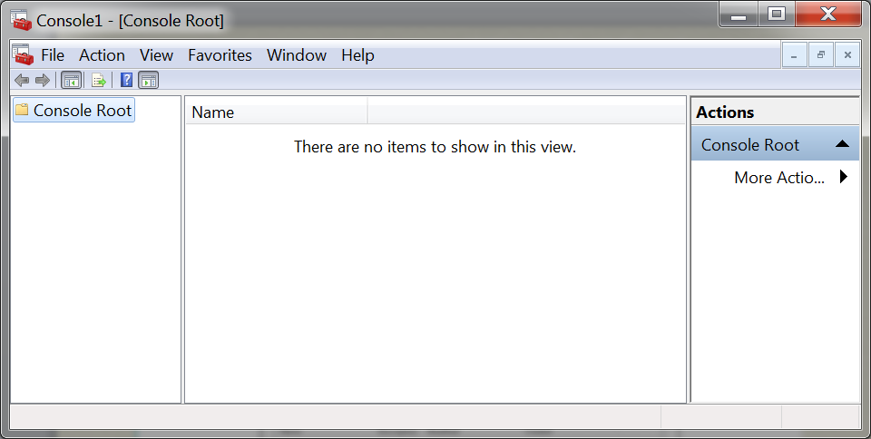
Microsoft Management Console (cont'd.)

Slide 31
Microsoft Management Console (cont'd.)
Can create a customized MMC console
  By adding the snap-ins you want to a single console
  And then saving the console as an .msc file
Can share .msc files between users and computers
  You may restrict the ability of others to modify them

Slide 32
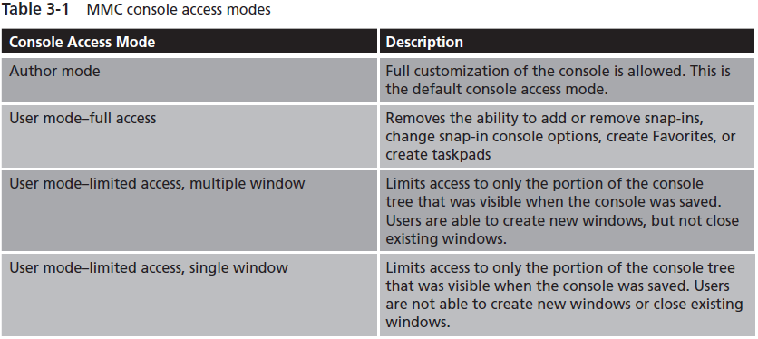
Microsoft Management Console (cont'd.)
found on page 125

Slide 33
Computer Management
CMC console
CMC Computer Management console accessed by right click on start button, right clicking on computer and choosing Manage from the list.
  Serves as a common troubleshooting and administrative interface for several snap-ins
  Divided into three sections
    System Tools, Storage, and Services and Applications
System Tool section contains:
  Task Scheduler
  Event Viewer
  Shared Folders
  Local Users and Groups

Slide 34
Computer Management (cont'd.)
System Tool section contains (cont'd.):
  Performance
  Device Manager
Storage section contains:
  Disk Management
Services and Applications section contains:
  Services
  WMI Control

Slide 35
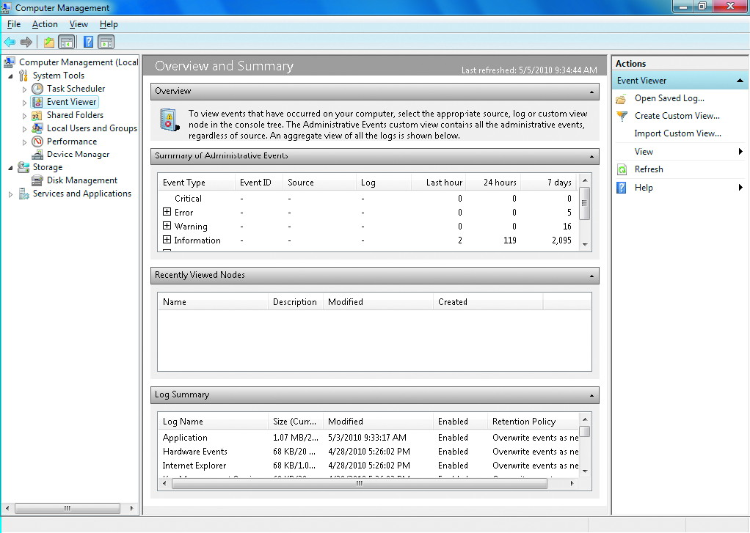
Microsoft Management Console
Event Viewer

Slide 36
Services
Services
  Type of Windows application that runs in the background without user interaction
  Typically perform tasks for other software applications
    Or perform housekeeping tasks for Windows 7
Services administrative tool
  Used to manage Windows 7 services

Slide 37
Services (cont'd.)
Service information
  Name
  Description
  Status
  Startup Type
  Log On As
Properties of a service
  General
  Log On
  Recovery
  Dependencies

Slide 38
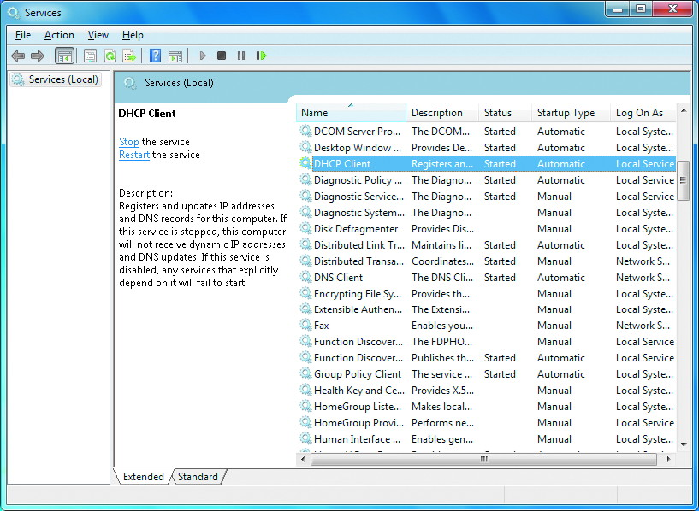
Services Screen

Slide 39
Hardware Management
Windows 7 supports a wide variety of internal and external hardware components
Windows 7 requires device drivers to manage and communicate with hardware components
Windows 7 Compatibility Center
  List of software or hardware and associated device drivers that have been tested with Windows 7

Slide 40
Device Drivers
Device drivers
  Allow Windows 7 to properly communicate with and use the functionality of a device
  Act as an intermediary between a hardware component and an operating system
  Contain the instructions on how to use the full capabilities of a device properly
In some cases, a device driver not specifically designed for a hardware component may allow that component to function

Slide 41
Device Driver Compatibility
Some device drivers for previous versions of Windows do not work properly with Windows 7
Potential compatibility issues
  64-bit version of Windows 7 requires 64-bit drivers
  All driver files referenced in an INF file must be part of the driver installation package
  Installers cannot display a user interface during installation
  Digital signatures are required for 64-bit drivers that run in kernel mode

Slide 42
Device Driver Compatibility (cont'd.)
Potential compatibility issues (cont'd.)
  Driver user interfaces may not appear properly
  Registry management changes for 64-bit Windows 7 may prevent drivers from updating settings properly
  Video drivers written for Windows 2000 or Windows XP cannot support the new Aero Glass interface
  Windows 7 uses the NDIS 6.20 interface for network devices
  Kernel mode printer drivers cannot be used in Windows 7

Slide 43
Device Manager
Device Manager
  Primary tool for managing device drivers
  View and modify hardware device properties
Tasks performed with Device Manager include:
  Determining if installed hardware is functioning correctly
  Viewing and changing hardware resource settings
  Determining and changing the drivers used by a device

Slide 44
Device Manager (cont'd.)
Tasks performed with Device Manager include (cont'd.):
  Enabling, disabling, and uninstalling devices
  Configuring advanced settings for devices
  Viewing and printing summary information about installed devices
After installing Windows 7
  Use Device Manager to confirm that all devices are working properly
You can install an updated device driver from the Driver tab in the Device Properties

Slide 45
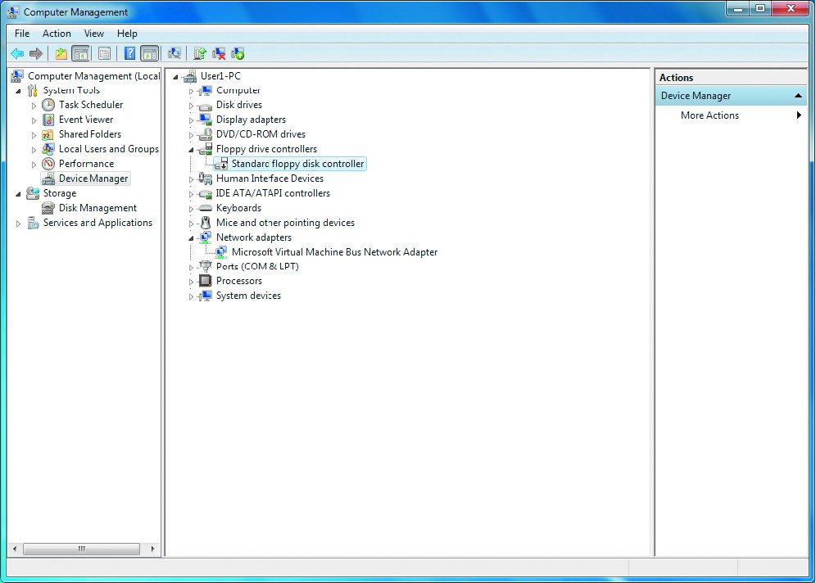
Device Manager Main Screen

Slide 46
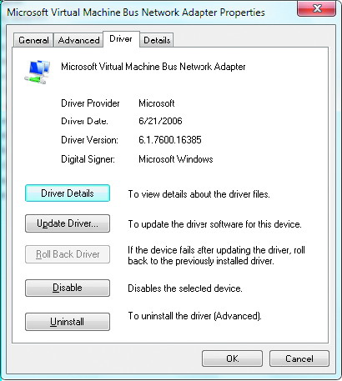
Device Dialog Box (Drives Tab)

Slide 47
Device Driver Signing
Windows 7 uses file signatures on system files to ensure system stability
Device driver signing
  Ensures that a driver for a specific hardware component has been verified by Microsoft
    From a known software publisher
  Ensures that the device driver has not been modified in any way since it was signed
Installing an unsigned driver generates the following messages:
  Windows can’t verify the publisher of this driver software
  This driver software has been altered
  Windows cannot install this driver software
File Signature Verification utility
  Verify that existing drivers and system files are signed

Slide 48
Hardware Component Installation
Components are assigned resource settings
  Allow them to access the system processor and memory in different ways
Four main resources
  Interrupt request (IRQ) lines
  Input/output (I/O) ranges
  Direct memory access (DMA) channels
  Memory address ranges
Windows 7 no longer supports legacy Industry Standard Architecture (ISA) devices

Slide 49
Hardware Component Installation (cont'd.)
Peripheral Component Interface (PCI) devices support plug and play
  Which automatically assigns resources to devices
Universal Serial Bus (USB) devices are also plug and play

Slide 50
Power Management
Minimizing power usage is driven by both cost and environmental factors
Windows 7 has a power management structure introduced in Windows Vista
  Relies on power management capabilities built into a computer to perform power management
Advanced Configuration and Power Interface (ACPI) standard
  Defines power states for global power management and individual devices

Slide 51
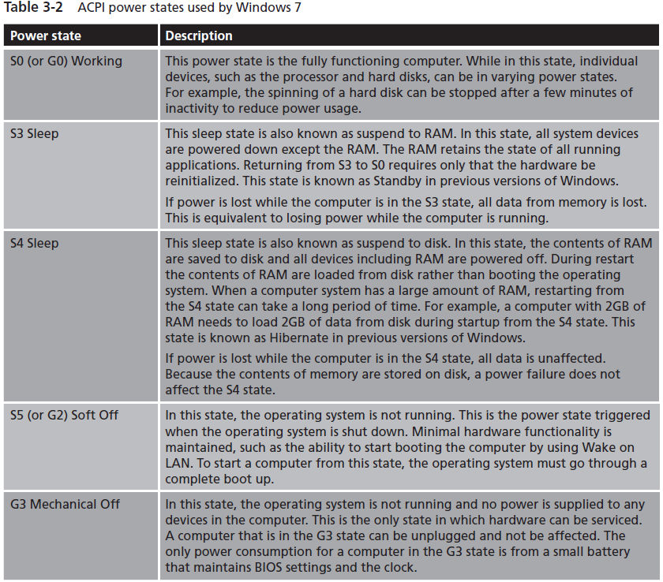
ACPI States
found on page 137

Slide 52
Sleep Mode in Windows 7
Previous versions of Windows had two sleep states
  Standby put the computer in the S3 state
  Hibernate put the computer in the S4 state
Windows 7 uses a combination of the S3 and S4 states called hybrid sleep
  Saves memory to disk when entering the S3 state
Hybrid sleep advantages:
  If power is lost in the S3 state, the computer can recover from the S4 state on reboot
  Eliminates the requirement to leave Standby mode to enter hibernation

Slide 53
Sleep Mode in Windows 7 (cont'd.)
Other enhancements to power management
  Resume from S3 state in less than 3 seconds
  Resume from S4 state in less than 10 seconds
  Updated USB hub driver that initializes faster
  Optimized use of processor power management
  Support for additional devices such as graphics cards and wireless network cards
  Support for screen brightness in policies
  Enhanced hard drive management by extending the time a hard drive is off
  Closing a laptop case can trigger sleep mode
  Sleep mode as default shutdown option to speed startup

Slide 54
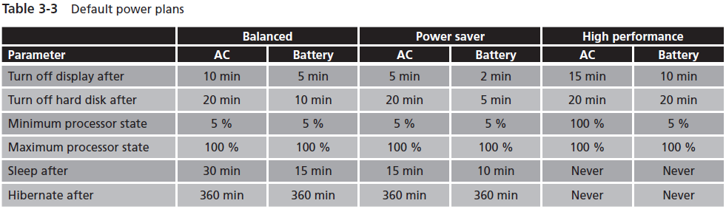
Power Plans
found on page 138

Slide 55
Away Mode
Computers in Away Mode are in the S0 state
  Computer looks and sounds like it is off
Maximizes all of the device level power savings
  While continuing to work in the background if required
Characteristics
  Video is blanked
  Audio is muted
  Keyboard and mouse input is filtered out
  S0 power state
  May still idle to sleep based on the power plan

Slide 56
Display
Windows 7 has an entirely new system for graphics presentation
Aero Glass interface requires a display driver that supports:
  Windows Display Driver Model (WDDM)
  Minimum of DirectX 9.0
In addition to transparency of windows, Aero Glass provides:
  Live taskbar thumbnails
  Windows Flip
  Windows Flip 3D

Slide 57
Display Settings
Allows you to configure the screen resolution and color depth for your display
  Other more complex options such as screen refresh rate are available in the Advanced Settings
Screen resolution
  Number of pixels that are displayed
Color depth
  Indicates how many bits of information are used to store color information about each pixel in the display

Slide 58
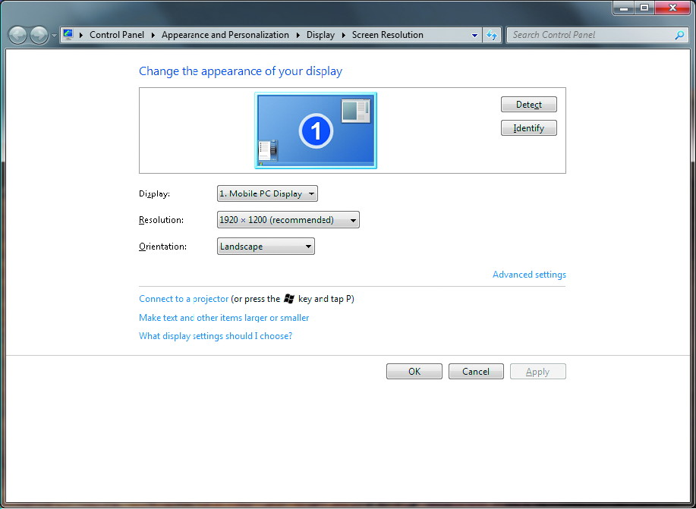
Display Settings Screen

Slide 59
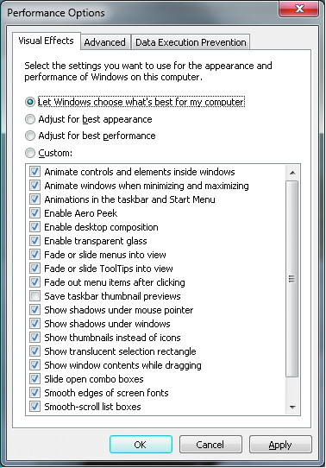
Visual Effects

Slide 60
Themes
Personalization applet
  Lets you select from several predefined color themes
    Controls the color of windows, backgrounds, sounds and screen saver
Some of the themes are high contrast to help people with visual impairments see information better

Slide 61
Desktop Backgrounds
Personalizing the desktop background
  One of the most common actions users want to perform when receiving a new computer
Windows 7 comes with a number of desktop backgrounds for you to choose from
When you select a desktop background
  Must also select how graphic is laid out on the page

Slide 62
Screen Savers
Screen savers were used to prevent screen burn in
  Now a security mechanism for locking a computer
To increase security
  Enable the On resume, display logon screen option

Slide 63
Multiple Monitors
Windows 7 supports multiple monitors attached to a single computer
Options
  Mirrored
  Extended
  External display only

Slide 64
Task Scheduler
Allows you to be proactive about computer maintenance
Many Windows maintenance tasks are now performed automatically by the Task Scheduler

Slide 65
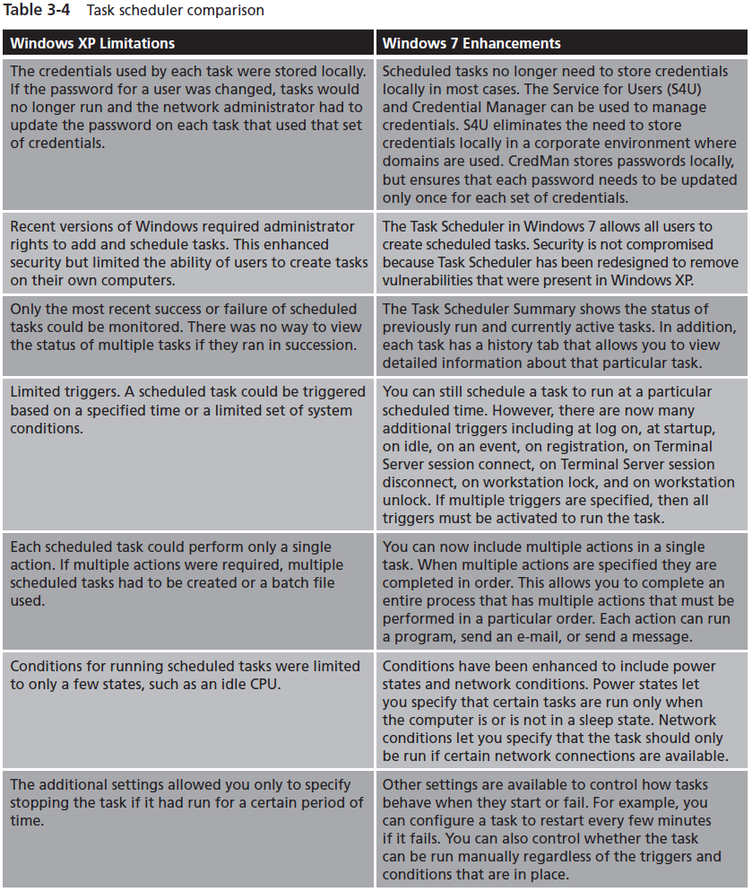
found on
page 148

Slide 66
Summary
Control Panel is a central location for management utilities
Administrative Tools is a collection of system maintenance utilities
Windows 7 uses device drivers to properly communicate with various hardware components
Device Manager is the MMC snap-in that is used to manage device drivers and hardware components
Windows 7 will allow 32-bit systems to install unsigned device drivers

Slide 67
Summary (cont'd.)
Enhanced Power Management in Windows 7
  Sleep feature easier to use
For Aero Glass interface, you need a video card and video driver that support the WDDM and DirectX 9.0c
Display can be customized by controlling the display resolution, color depth, and refresh rate
Enhanced Task Scheduler with security improvements for credentials, improved logging, and expanded triggers for starting tasks

